Slide 1
Legislative Reception January 29, 2020
Save the Date

Slide 2
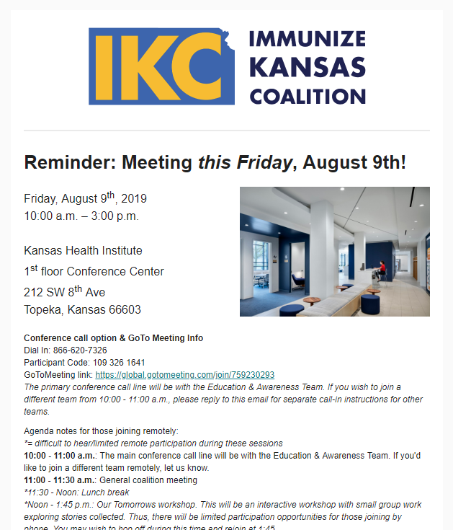
IKC is sending updates from a new
email address!
Be sure to whitelist us.
immkscoalition@gmail.com

Slide 3
Thanks for exhibiting for IKC at a fall conference!
Robin Simmons
Dan Leong
Mary Beth Warren
Carlie Houchen
Dean Benton
Cindy Olson-Burgess
Trish Long

Slide 4
Over the past month, IKC’s Facebook reached over 3,200 people!

Slide 5
Check out the #KansasFightsFlu toolkit on the IKC website!

Slide 6
Follow IKC on Twitter @ImmKSCoalition

Slide 7
Keep sharing the HPV Vaccine Videos! www.immunizekansascoalition.org

